Slide 1
Inland Boating
Chapter
7

Slide 2
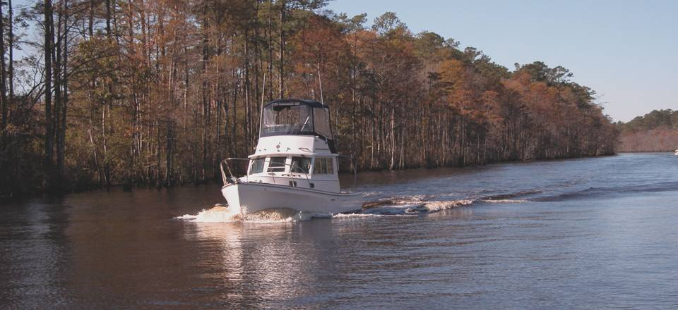
Inland Boating
Chapter
7

Slide 3
Lesson Objectives
Nature of inland waters
Navigation Rules
Aids to Navigation
Crossing and Passing Daymarks
Hazards
River charts
Navigating inland waters

Slide 4
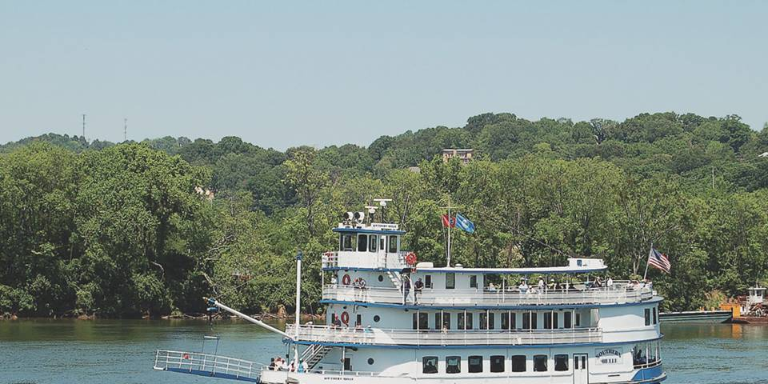
Inland Boating
Inland Waters include Rivers, Lakes and Canals
Maintained by Army Corp of Engineers

Slide 5
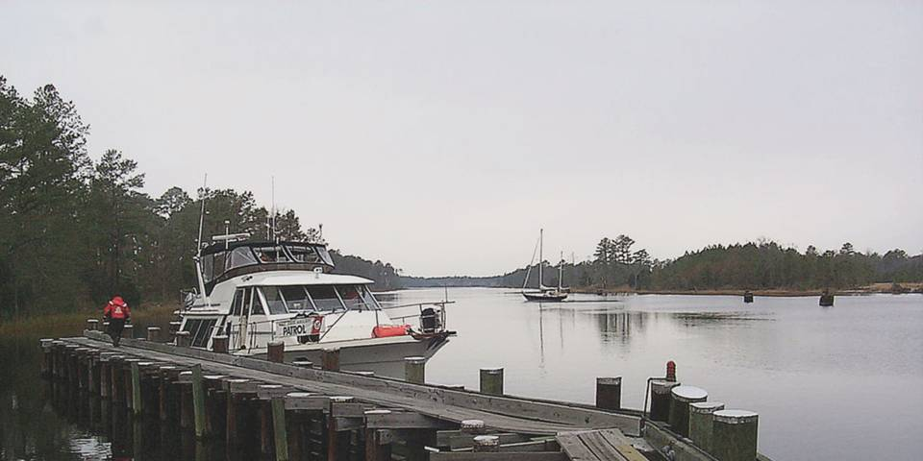
Inland Waters
Rivers – May be considered Navigable or Navigable Waterways
Include Great Lakes and ICW
Lakes – Natural, Impounded, Dammed

Slide 6
Inland Navigation
Inland Rules (chapter 6)
In force on navigable waters inland of the demarcation lines.
Use common sense on ALL rivers and waterways
ATONS
US Aids to Navigation System

Slide 7
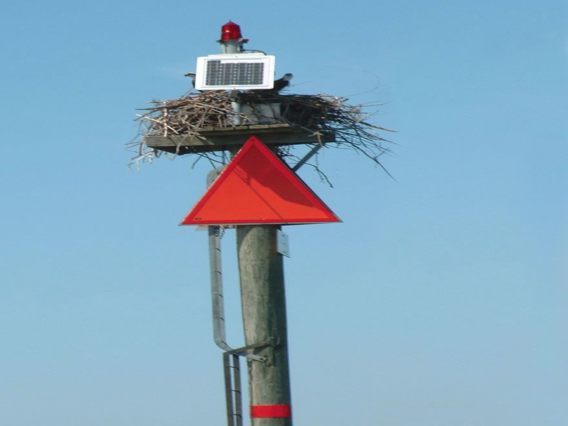
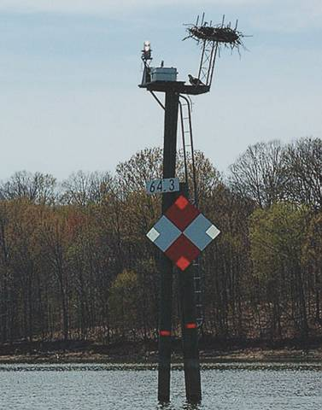
Inland Navigation
Western Rivers ATONS
Right descending bank
Left descending bank
Passing Daymarks
Crossing Daymarks
Diamond shape
Green and white checkerboard
Red and white checkerboard

Slide 8
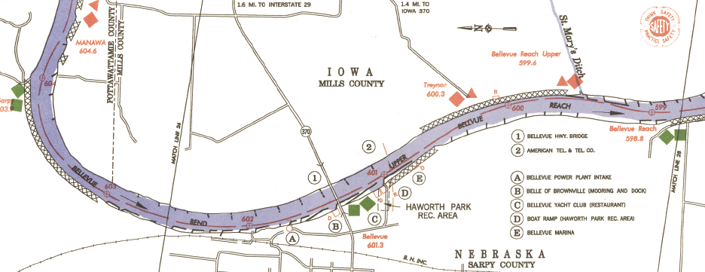
Inland Navigation
Western Rivers ATONS
Charts do not show navigation lights

Slide 9
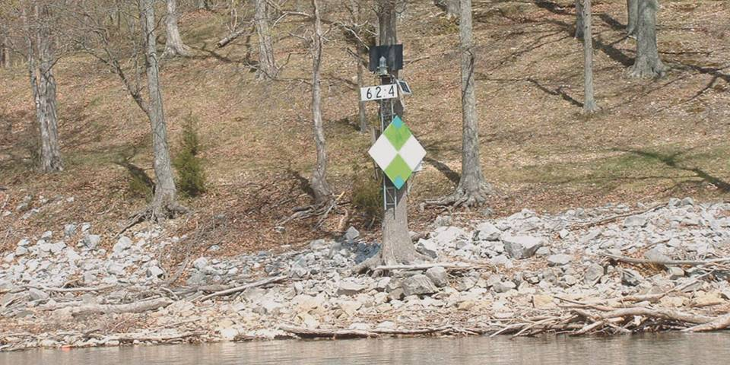
Inland Navigation
Western Rivers ATONS
Mississippi River and its tributaries
Channel on side with Daymark

Slide 10
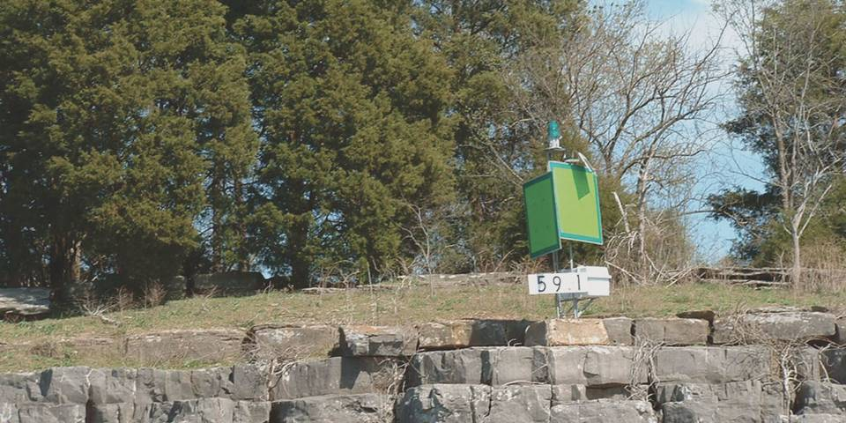
Inland Navigation
Western Rivers ATONS
Mile Markers
Passing Daymarks
Buoys are not marked on chart

Slide 11
Inland Navigation
Uniform State Waterways Marking System
Three types of markers
Regulatory
ATONS
Mooring

Slide 12
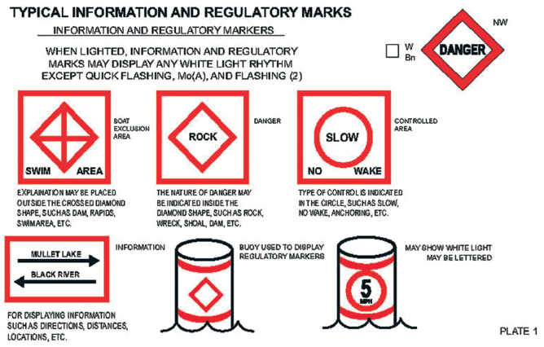
INFORMATION and REGULATORY

Slide 13
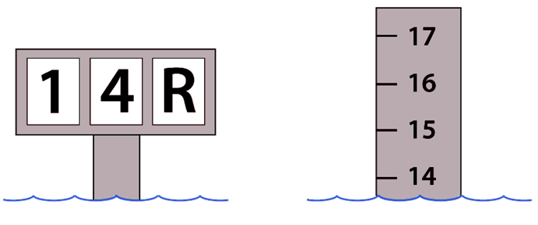
Inland Seamanship
Changing water depths and current speeds represent dangers

Slide 14
Inland Seamanship
Hazards of lakes
Spring fed lakes present hypothermia risks
Submerged objects
Lake water levels
During high water be aware of low overhead clearances
Down stream of Dams turbulent and dangerous
Learn Local Conditions!

Slide 15
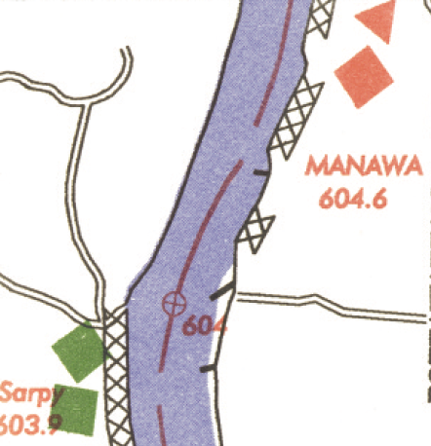
Student Activity
As you travel upstream which bank is on your Port side?
Right
Left
Left Descending Bank
Right Descending Bank
Right

Slide 16
River Currents
River Currents
Can be quite strong
Are concentrated in the channel
Hinder movement up stream
Aid movement down stream
May run in different directions at different depths
Right of way given to down bound vessels

Slide 17
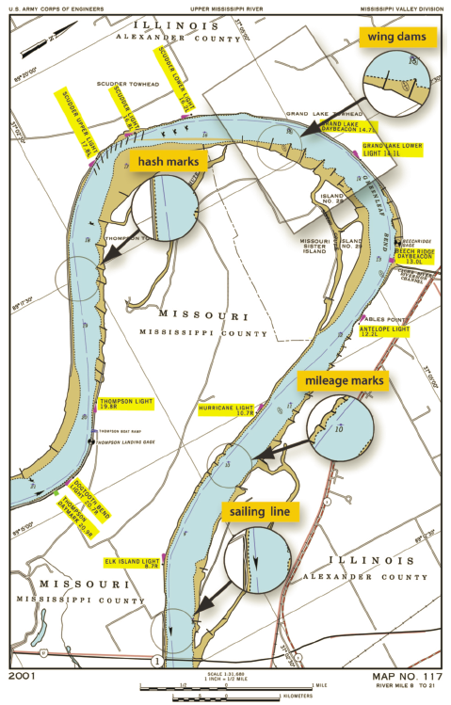
River Currents
River bends
Outside bend (usually deeper)
Inside bend
Differences can cause eddies and slack water
Reduce speed as wake can erode banks

Slide 18
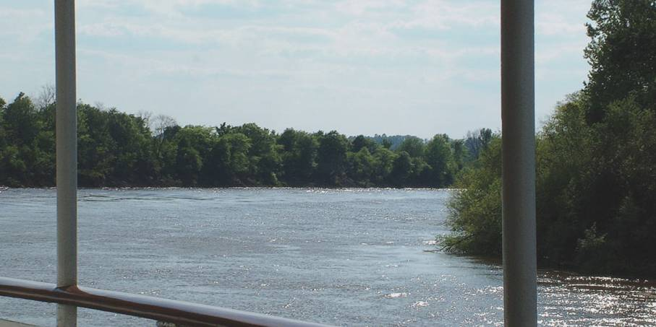
River Currents
Other river challenges
Entering a current
River debris

Slide 19
Maintaining Inland Waterways
Corp of Engineers
Creates charts
Levees
Revetments
Facing of stone or concrete
Wing Dams or Dikes
Direct current into channel
Beware that river courses change!

Slide 20
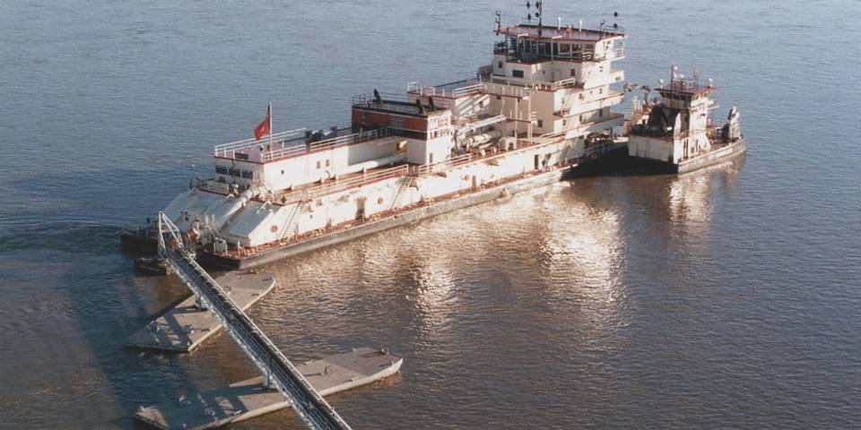
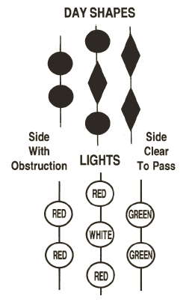
Maintaining Inland Waterways
Dredging

Slide 21
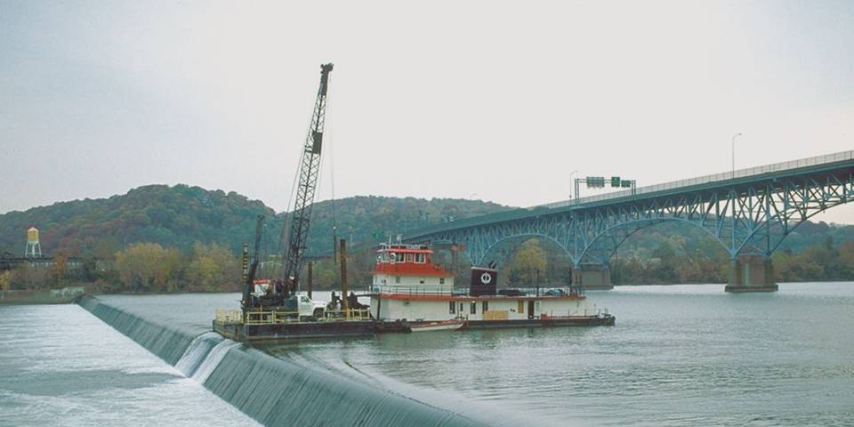
Dams
Lowhead Dams
Present on many rivers
Most dangerous for boaters
Dangerous backwash
Escape difficult if caught in the “boil”
Swim under and down stream
Know where they are and avoid them

Slide 22
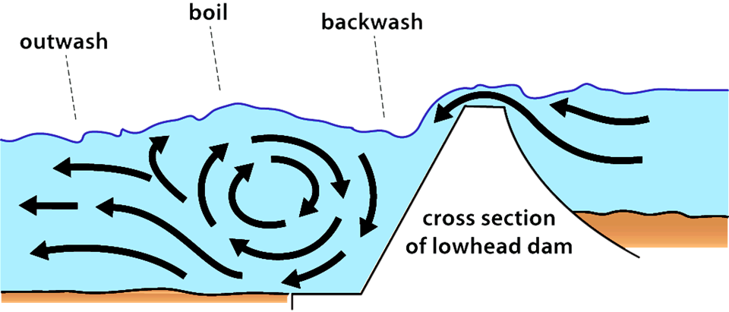
Lowhead Dam
“Efficient, Self-operating Drowning Machines”

Slide 23
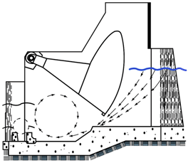
High Dams
Stay out of restricted areas
Marked by signs, buoys, and/or flashing lights
Upstream – strong undertows
Downstream – tailrace boils & backwash
Dam gates
Wicket gates
Tainter gates

Slide 24
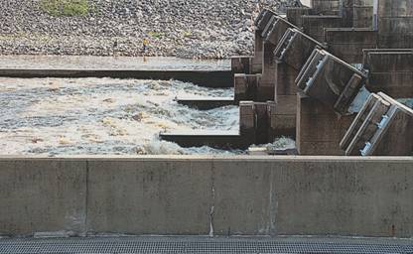
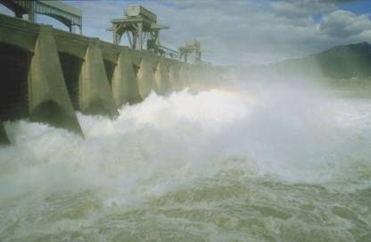
Fishing Below Dams
Dangerous
Tailrace
Hydroelectric turbines
Tailrace
White water below Dam

Slide 25
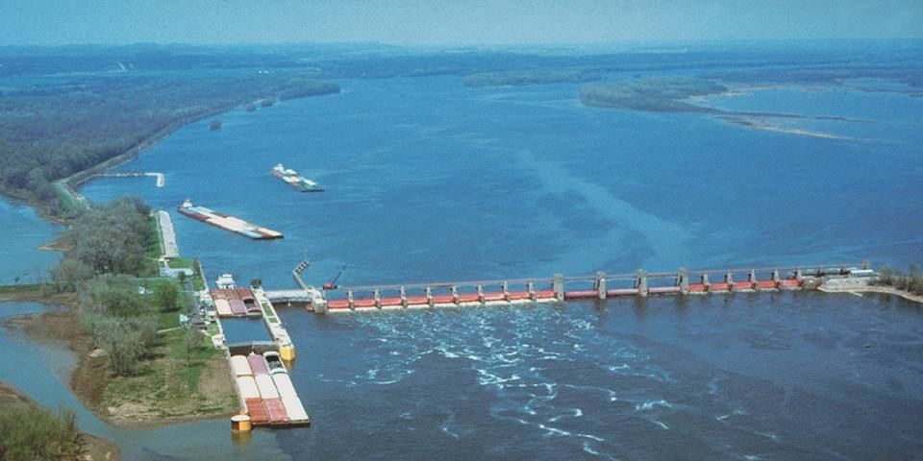
Locks
Used to raise and lower vessels passing from one body of water to another

Slide 26
Locks
Priority for use
Military use and mail packets
Commercial vessels
Recreational vessels

Slide 27
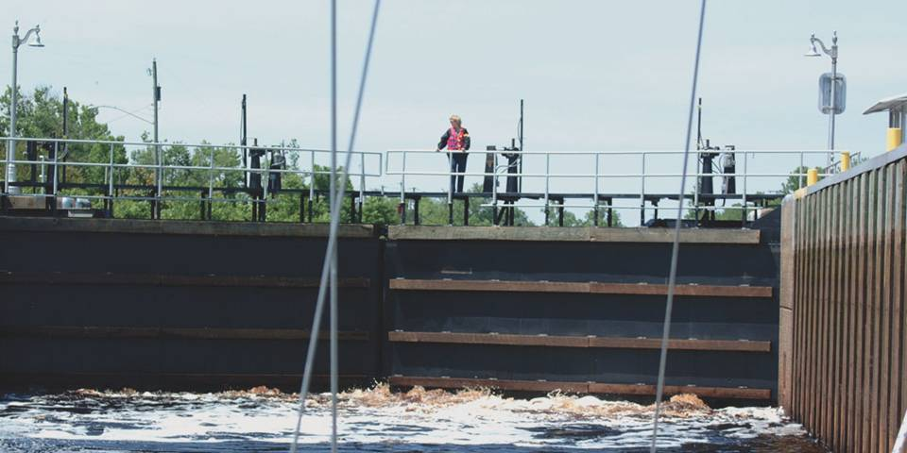
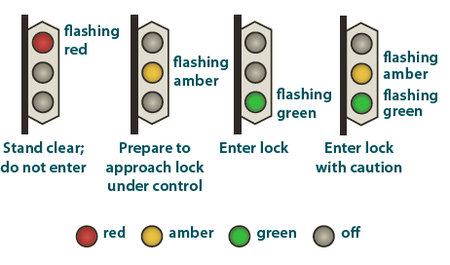
Lock Master
Lock Master can be reached on Ch. 16 then switch to working Ch. 13

Slide 28
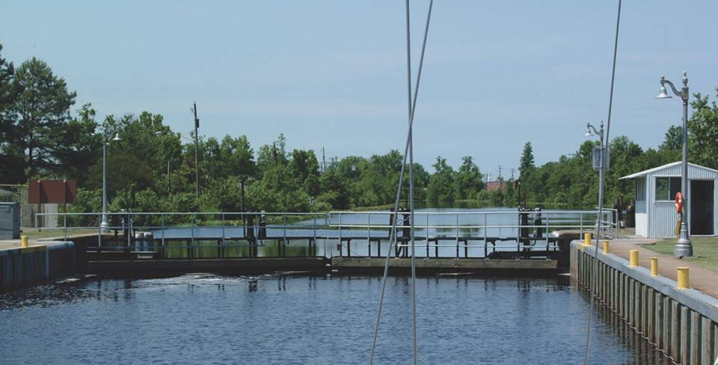
Locking Through
Wear PFD
Approach slowly
No smoking
Tie up-use own lines and fenders
Move out slowly when permitted

Slide 29
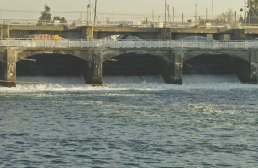
Student Activity
What is the gravest danger in a dam?
Tailrace

Slide 30
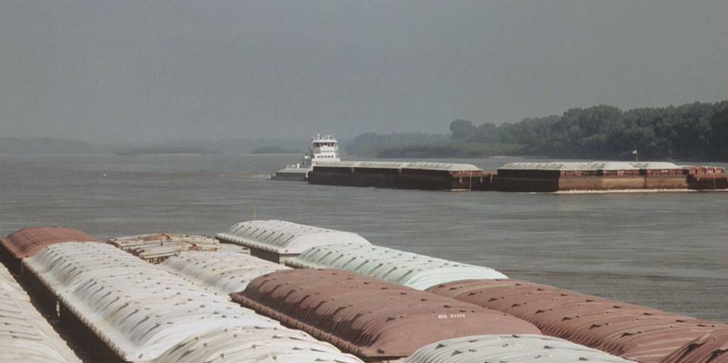
Commercial Traffic
Beware – Ocean Going Tows can be found on many rivers
Watch out for the tow
Keep clear
Beware of prop wash
Blind spots
Danger zones
VHF communication Bridge-to-Bridge Ch. 13
Reprinted with permission from Seaworthy: Essential Lessons from BoatU.S.;s 20 year Case File of Things Gone Wrong by Robert A. Adriance”

Slide 31
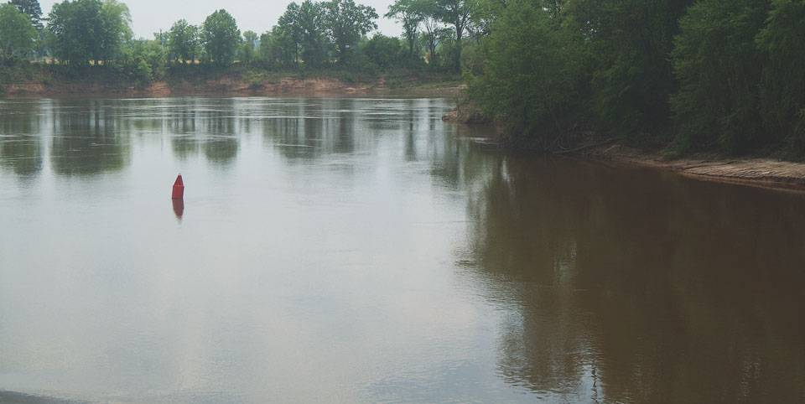
Before You Go
Study river’s chart
If moving from one fresh water body to another, observe precautions regarding non-native aquatic nuisance species (ANS)
Review drawbridge signals and regulations
Review Locks signals and regulations
All Local and State regulations

Slide 32
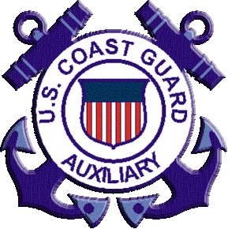
Thank you
Illustrations provided by McGraw Hill Education
The

